Slide 1
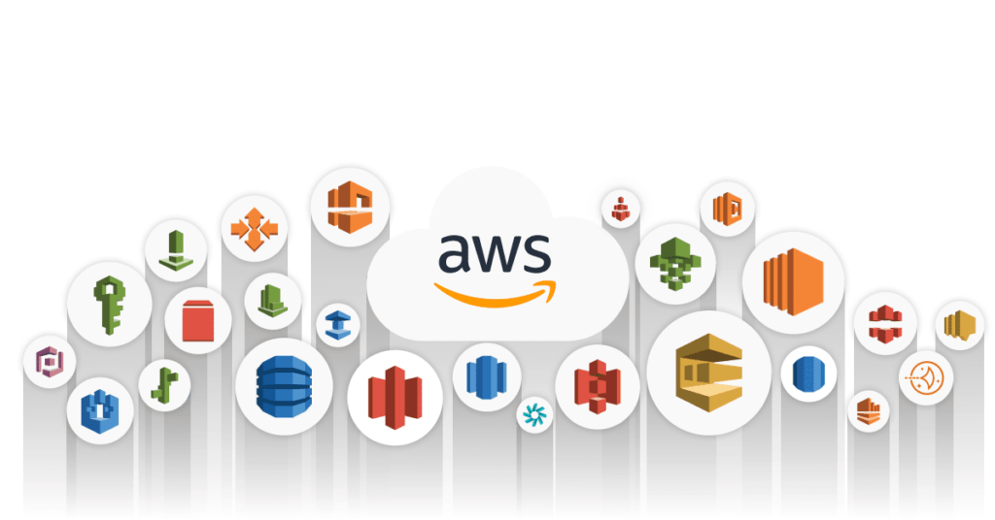
AWS Features, usage and Deployment for IOT Applications
By
Prof. Rajesh R M
Assistant Professor, Dept. of AIML
RVCE, Bangalore

Slide 2
Outline
Amazon EC2
Amazon Autoscaling
Amazon s3
Amazon RDS
Amazon Dynamo DB
Amazon Kinesis
Amazon SQS
Amazon EMR
AWS Cloud Features for IoT
Usage of AWS for IoT Applications
Deployment for IoT Applications

Slide 3
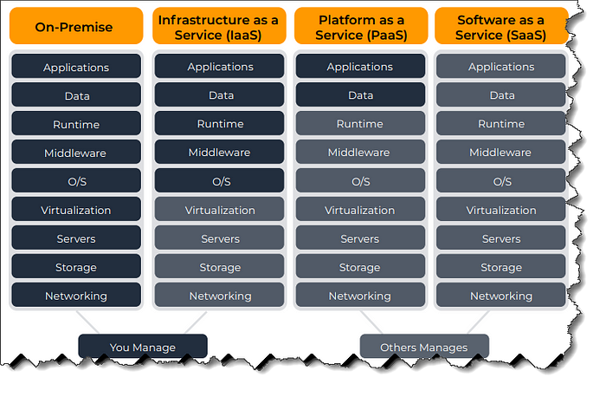
AWS Services

Slide 4
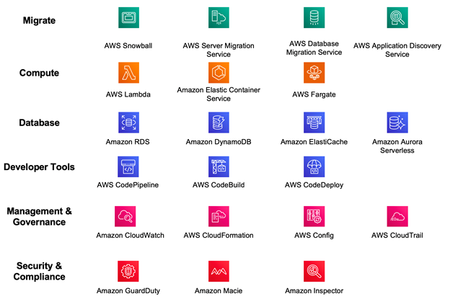
AWS Services

Slide 5
Amazon EC2
Amazon EC2 (Elastic Compute Cloud) is one of the core services provided by Amazon Web Services (AWS), offering resizable compute capacity in the cloud.
Key Features
Scalability
Variety of Instances
Elastic Load Balancing
Auto scaling
Common Use Cases
Web Hosting
Big Data Processing: High-Performance Computing (HPC)
Application Development and Testing:
Backup and Disaster Recovery

Slide 6
Auto Scaling
Amazon Auto Scaling is a feature within Amazon Web Services (AWS) that automatically adjusts the number of compute resources (like Amazon EC2 instances) in response to changing demand.
Key Features of Amazon Auto Scaling
Dynamic Scaling
Predictive Scaling
Scaling Policies
Multi-Service Support
Health Checks and Replacement
How Amazon Auto Scaling Works
Auto Scaling Groups
Scaling Policies
Launch Configurations/Launch Templates
Monitoring and Metrics

Slide 7
Amazon s3
Amazon S3 (Simple Storage Service) is a scalable object storage service provided by Amazon Web Services (AWS).
How Amazon S3 Works
Buckets and Objects
Storage Management
Access Control
Data Transfer and Retrieval
S3 Bucket Addressing (URL Structure)
Virtual Hosted-Style URLs: https://my-bucket.s3.us-west-2.amazonaws.com/image.png
Path-Style URLs: https://s3.us-west-2.amazonaws.com/my-bucket/image.png
Accessing via AWS Console
S3 Management Console: You can navigate to the S3 Management Console in the AWS Management Console, select the bucket, and view or manage its contents.
Direct Object Access: You can copy the object URL directly from the S3 console by selecting the object and clicking on "Copy URL".

Slide 8
Amazon RDS
Amazon RDS (Relational Database Service) is a managed relational database service provided by AWS that makes it easy to set up, operate, and scale a relational database in the cloud.
Multiple Database
Amazon Aurora: A MySQL- and PostgreSQL-compatible relational database built for the cloud.
MySQL: The popular open-source relational database.
PostgreSQL: An advanced open-source relational database with support for complex queries and data types.
MariaDB: A fork of MySQL that is community-developed.
Oracle: A widely-used enterprise database with robust features.
Microsoft SQL Server: A relational database from Microsoft, widely used in enterprise environments.

Slide 9
Amazon DynamoDB
Amazon DynamoDB is a fully managed NoSQL database service provided by AWS, designed for fast and predictable performance with seamless scalability.
Flexible Data Models:
Key-Value Model: Stores data as key-value pairs where each item is uniquely identified by a primary key.
Document Model: Supports complex data structures with nested attributes, allowing you to store JSON-like documents.
Common Use Cases
Web and Mobile Backends.
Gaming
IoT Applications
Real-Time Analytics

Slide 10
Amazon Kinesis
Amazon Kinesis is a set of services offered by AWS that enables you to collect, process, and analyze real-time streaming data.
Key Components of Amazon Kinesis
Real-Time Processing: Ingest and process data in real-time as it arrives.
Scalability: You can scale the data stream by adding or removing shards, depending on your throughput requirements.
Durability: Data is stored in shards and can be retained for up to 365 days.
Data Consumers: You can build custom applications using AWS SDKs to process the data, or use Kinesis Data Firehose or Kinesis Data Analytics for further processing.
Use Cases: Real-time log processing, event tracking, and real-time analytics

Slide 11
Amazon Simple Queue Service (SQS)
Amazon Simple Queue Service (SQS) is a fully managed message queuing service offered by AWS that enables you to decouple and scale microservices, distributed systems, and serverless applications.
Common Use Cases
Decoupling Microservices: SQS enables microservices to communicate asynchronously by sending messages to a queue, where they are stored until the receiving service processes them.
Task Queues: SQS can be used to manage tasks that need to be processed asynchronously, such as image processing, email sending, or data processing.
Buffering Requests: Acts as a buffer between incoming requests and the backend processing, ensuring that your application can handle varying loads.
Distributed Systems Communication: Facilitates communication between components of distributed systems, ensuring reliable message delivery.

Slide 12
Amazon EMR
Amazon EMR (Elastic MapReduce) is a cloud-based big data platform provided by AWS that makes it easy to process and analyze large datasets using popular big data frameworks such as Apache Hadoop, Apache Spark, Apache HBase, Apache Flink, and Presto
Multiple Framework Support:
Apache Hadoop: For distributed data processing using the MapReduce programming model.
Apache Spark: For fast, in-memory data processing and machine learning.
Apache HBase: A NoSQL database for real-time, random access to large datasets.
Apache Flink: For stateful stream processing.
Presto: A distributed SQL query engine for interactive analytics on large datasets.

Slide 13
1. AWS IoT Core
Device Connectivity and Management: Allows secure device connectivity and messaging between IoT devices and the cloud.
Device Shadows: Provides a persistent, virtual representation of each device, which includes the device's last reported state and desired future state.
Rules Engine: Helps process and route data from IoT devices to other AWS services based on predefined rules.
2. AWS IoT Device Management
Onboarding and Organizing Devices: Supports device registration, organization, and group management.
Over-the-Air Updates (OTA): Allows for remote software updates to IoT devices, ensuring they run the latest firmware and applications.
Fleet Indexing and Search: Facilitates searching for devices based on device attributes, status, or any other metadata.

